Slide 1
Behavioural & Experimental Economics Judgment under Risk & Uncertainty
Adrien Fillon
University of Cyprus

Slide 2
Course Outline
Choice under Certainty
Judgement under Risk & Uncertainty
Choices under Risk & Uncertainty
Intertemporal Choice
Strategic Interaction

Slide 3
Course Outline
Choice under Certainty
Judgement under Risk & Uncertainty
Probability Judgement
Judgement under Risk & Uncertainty
Choices under Risk & Uncertainty
Intertemporal Choice
Strategic Interaction

Slide 4
Judgement under Risk & Uncertainty
We will examine phaenomena that appear to be inconsistent with a correct application of Probability Theory to formulate judgments.
Ignoring independence
Conjunction and Disjunction fallacies
Base-rate neglect
Confirmation bias
Availability
Overconfidence
We will also look at some heuristics that may give rise to these biases

Slide 5
Linda is 31 years old, single, outspoken, and very bright. She majored in philosophy.
As a student, she was deeply concerned with issues of discrimination and social justice and also participated in anti-nuclear demonstrations.
(a) What is the probability that Linda is a bank teller?
(b) What is the probability that Linda is a bank teller and a feminist?

Slide 6
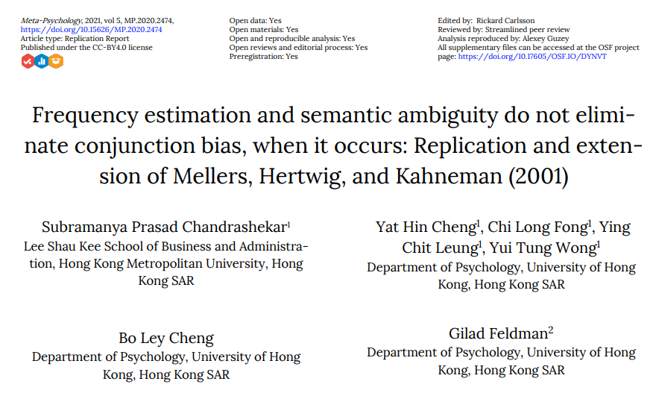
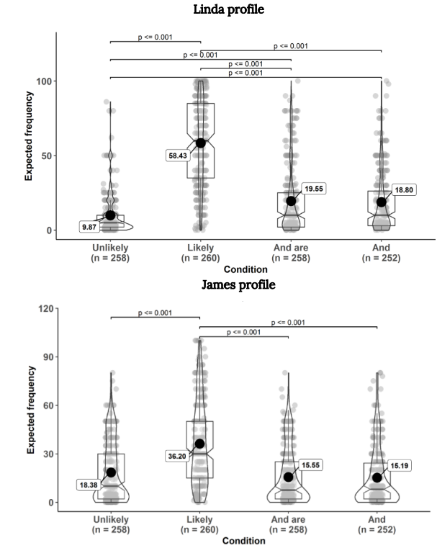
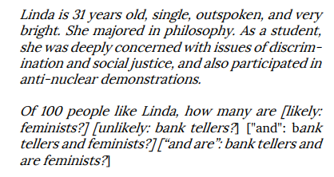
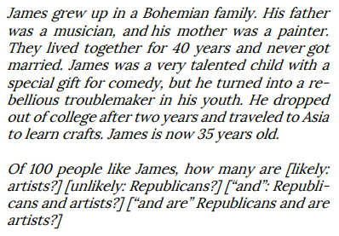

Slide 7
Independence
The notion of independent probabilities is critical
in economic and finance: Diversification, i.e. don’t put all your eggs in one basket.
in engineering: multiple safety systems and redundancy.
Two ways to make mistakes:
Think that outcomes are independent when they are not.
Think that outcomes are not independent when in fact they are.

Slide 8
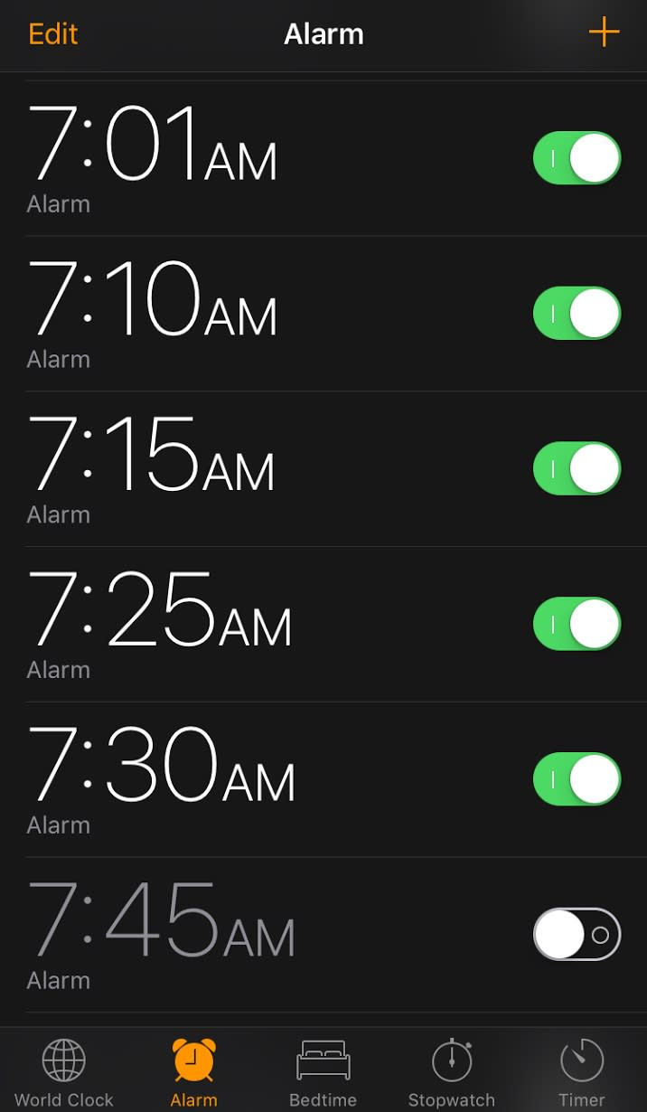
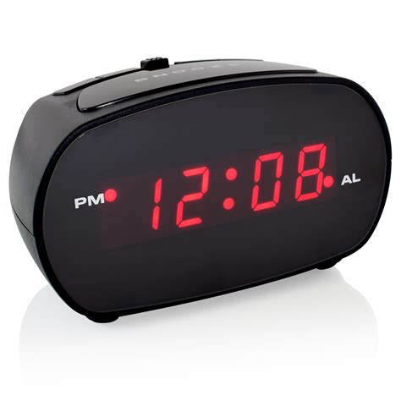
Notes:
Independence : not useful to set up multiples alarms on the same device, use a second one.

Slide 9
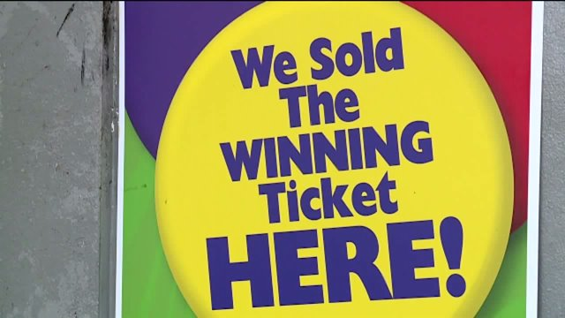
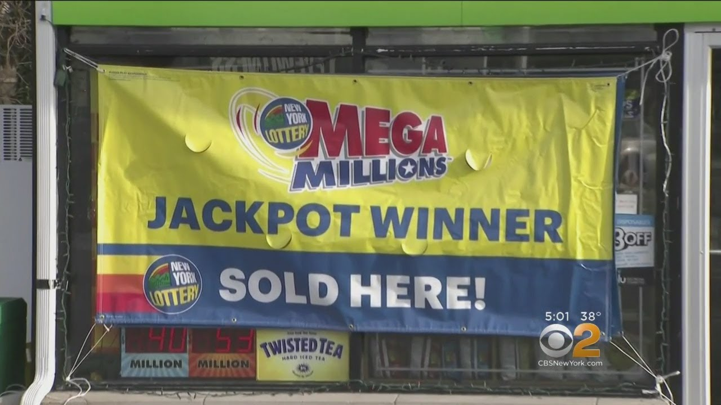
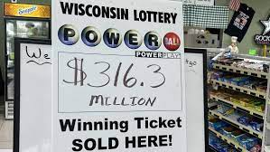

Slide 10
Gambler’s fallacy
The gambler’s fallacy is a specific case of thinking that two outcomes are dependent when they are not.
It consists in thinking that a departure from the average behavior os some system will be corrected in the short term.
For example, a gambler has lost 30 times in a row on a slot machine and leaves it. Someone else plays the machine because it is “due” to have a winning spin.

Slide 11
Example
Suppose you flip a fair coin 8 times. Which of the following sequences is more likely to occur?
HHHHHHHH
HHHHHHHT
HTTTHHTH

Slide 12
Example
Same with a dice
4-3-6-2-1
6-6-6-6-6

Slide 13
Representativeness heuristic
Recall that heuristics are simple rules of thumb that are often used in judgment and decision making.
When using the representativeness heuristic, you estimate the probability that some outcome was the result of a given process by reference to the degree to which the outcome is representative of that process.
Like all heuristics, in a wide variety of contexts it leads to good outcomes. But it can also generate systematic patterns of mistakes. For example, it can lead to the Gambler’s Fallacy.

Slide 14
The Law of Small Numbers
The law of small numbers says that small samples resemble the distribution from which they were drawn.
Example: Bob flips a coin 3 times and gets 3 heads. He concludes that the coin must be biased.

Slide 15
Example
A Boeing 747-400 has around 6 million parts. Suppose that each part is very reliable and only fails with probability 0.000001. Assuming that faillures are independent events, what is the probability that all parts work?

Slide 16
Example
A Boeing 747-400 has around 6 million parts. Suppose that each part is very reliable and only fails with probability 0.000001. Assuming that faillures are independent events, what is the probability that all parts work?
The probability that any one part works is 0.999999, so the probability that all parts work is (0.999999)^{6,000,000} ≈ 0.0025 = 0.25%

Slide 17
Conjunction & disjunction fallacies
Conjunction fallacy: overestimate the probability of a conjunction, e.g. “A and B”.
Disjunction fallacy: underestimate the probability of a disjunction, e.g. “A or B”.
These are very important in the context of planning complex projects and may lead to the planning fallacy: the mistake of making plans based on predictions that are unreasonably similar to best-case scenarios.

Slide 18

Example
Rail projects
In more than 90% of rail projects undertaken worldwide between 1969 and 1998, planners overestimated the number of passengers who would use the systems by 106%. Cost overruns averaged 45%. Even more interestingly, estimates over the course of this period did not improve. That is, knowing about others’ failed forecasts did not prompt planners to make theirs more realistic.

Slide 19

Many people consider the Sydney Opera House to be the champion of all planning disasters.
According to original estimates in 1957, the opera house would be completed early in 1963 for $7 million. A scaled-down version of the opera house finally opened in 1973 at a cost of $102 million.

Slide 20
Disjunction
The probability of getting a six in a single dice roll is 1/6 ≈ 16.66% What is the probability of getting at least one six if you roll a dice 2 times?
Notes:
Not 16.66 * 2
1-(5/6)² = 30.6%
For three dices it's 1-(5/6)^3 around 42% and not 50%

Slide 21
Example
The probability of getting a six in a single dice roll is 1/6 ≈ 16.66% What is the probability of getting at least one six if you roll a dice 2 times?
It is one minus the probability of getting no six in two rolls:
1 – (5/6)² ≈ 30.6

Slide 22
Example
The probability of getting a six in a single dice roll is 1/6 ≈ 16.66% What is the probability of getting at least one six if you roll a dice 10 times?
Less than 10%
10%-50%
50%
50%-90%
More than 90%

Slide 23
Example
The probability of getting a six in a single dice roll is 1/6 ≈ 16.66% What is the probability of getting at least one six if you roll a dice 10 times?
Less than 10%
10%-50%
50%
50%-90% 83.8%
More than 90%
Notes:
1 − (5/6)10

Slide 24
You plan to go on a hike in spite of the fact that a tornado watch is in effect. The national weather service tells you that for every hour in your area, there is a 30 percent chance that a tornado will strike.
That is, there is a 30 percent chance that a tornado will strike your area between 10 am and 11 am, a 30 percent chance that a tornado will strike your area between 11 am and noon, and so on.
(a) What is the probability of a tornado striking your area at least once during a two-hour hike?
(b) What is the probability of a tornado striking your area at least once during a three-hour hike?
(c) What is the probability of a tornado striking your area at least once during a ten-hour hike?
Notes:
70%^hour
So A = 51%
B 66%
C 97%

Slide 25
What explains it?
One possibility to explain the conjunction and disjunction fallacies is through the anchoring-and-adjusting heuristic.
Overestimate conjunction:
For Pr(A and B), take Pr(A) or Pr(B) and adjust downwards insufficiently.
Underestimate disjunction:
For Pr(A or B), take Pr(A) or Pr(B) and adjust upwards insufficiently.

Slide 26
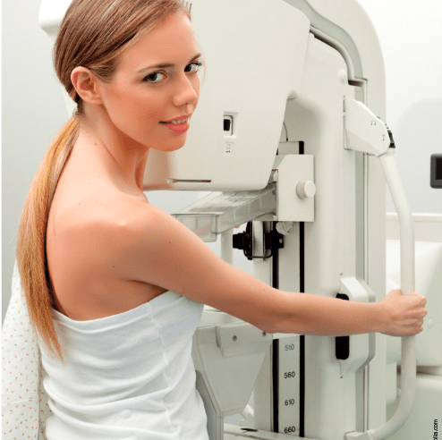
Risk assessment- Mammograms
Doctors often encourage women over a certain age to participate in routine mammogram screening for breastcancer.
Cette photo de Auteur inconnu est fournie sous licence CC BY-SA.

Slide 27
Example
Suppose that from past statistics about some population, the following is known.
At any one time, 1% of women have breast cancer. The test administered is correct in 90% of cases. That is, if the woman has cancer, there is a 90% probability that the test will be positive and 10% probability that it will be negative. If the woman does not have cancer, there is a 10% probability that the test will be positive and a 90% probability that it will be negative.
Suppose a woman has a positive test result during a routine screening.
Without knowing any other symptoms, what is the probability that she has breast cancer?
Less than 10%
10%-50%
50%
50%-90%
More than 90%

Slide 28
Total Probability and Bayes’s Rule
The Rule of Total Probability:
Pr(D)=Pr(D|B)*Pr(B)+Pr(D|¬B)*Pr(¬B)
Bayes’s Rule:
Pr(B|D)=Pr(D|B)*Pr(B)/Pr(D)
By applying the Rule of Total Probability to the denominator, we get:
Pr(D|B)*Pr(B)
Pr(D|B)*Pr(B) + Pr(D|¬B)*Pr(¬B)
Pr(B|D) =

Slide 29

Example
Suppose that from past statistics about some population, the following is known.
At any one time, 1% of women have breast cancer. The test administered is correct in 90% of cases. That is, if the woman has cancer, there is a 90% probability that the test will be positive and 10% probability that it will be negative. If the woman does not have cancer, there is a 10% probability that the test will be positive and a 90% probability that it will be negative.
Suppose a woman has a positive test result during a routine screening.
Without knowing any other symptomsm what is the probability that she has breast cancer?
Less than 10%
10%-50%
50%
50%-90%
More than 90%

Slide 30
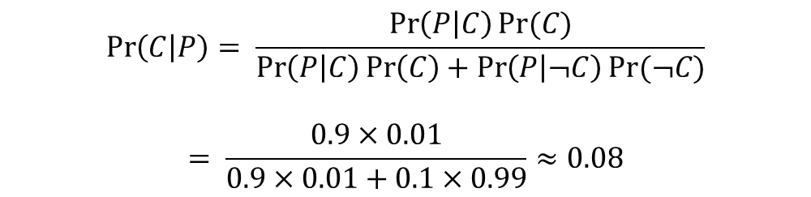
Example
Suppose that from past statistics about some population, the following is known.
At any one time, 1% of women have breast cancer. The test administered is correct in 90% of cases. That is, if the woman has cancer, there is a 90% probability that the test will be positive and 10% probability that it will be negative. If the woman does not have cancer, there is a 10% probability that the test will be positive and a 90% probability that it will be negative.
Suppose a woman has a positive test result during a routine screening.
Without knowing any other symptomsm what is the probability that she has breast cancer?
Less than 10%
10%-50%
50%
50%-90%
More than 90%
$$\operatorname{Pr}\left(C | P\right)= \frac{\operatorname{Pr}\left(P | C\right)Pr⁡(C)}{\operatorname{Pr}\left(P | C\right)\operatorname{Pr}\left(C\right)+\operatorname{Pr}\left(P | ¬C\right)Pr⁡(¬C)}$$
$$= \frac{0.9×0.01}{0.9×0.01+0.1×0.99}≈0.08$$

Slide 31
Base-rate neglect
The base rate is the fraction of some population that has some characteristic of interest (such as cancer, the common cold, or the Y chromosome)
Base-rate neglect refers to the failure to take the base rate properly into account in probabilistic judgment.

Slide 32
A cab company was involved in a hit-and-run accident at night.
Two cab companies, the Green and the Blue, operate in the city. You are given the following data: 85 percent of the cabs in the city are Green, 15 percent are Blue. A witness identified the cab involved in the accident as Blue. The court tested the reliability of the witness under the same circumstances that existed on the night of the accident and concluded that the witness correctly identified each one of the two colors 80 percent of the time and failed 20 percent of the time. What is the probability that the cab involved in the accident was Blue rather than Green?
Notes:
Pr (B|P) = PsuccessbluexPpercentblue / same + failedxgreen
8/10*15/100
8/10*15/100+2/10*85/100 ≈ 41%

Slide 33
Consequences of Base-rate neglect
When the base rate is too low or too high, tests become non-diagnostic: a ‘positive result’should not change our belief substantially. Base rate neglect might lead someone to rely on tests that are non-diagnostic, leading to many false-positives or false negatives.
Can also help explain the planning fallacy: planners may ignore the ‘base-rate’ of most projects running late and/or over budget.

Slide 35
Example from last lecture
Wes and John are trying to determine whether or not a coin has two heads. They cannot see the coin and only know the outcome after it is flipped.
Wes believes with 50% confidence that it has two heads. John thinks it is unlikely and assigns a probability of only 1% to that.
The first flip is heads. What is his updated probability?
Suppose the next flips all continue coming out of heads. How is the updated probability changing?

Slide 36
After 15 flips, all coins landed on head.
both assigned a probability of almost 100 percent to the possibility that the coin had two heads
People sometimes refer to this phenomenon as washing out of the priors. That is, after so many flips, John and Wes will assign roughly the same probability to the hypothesis, independently of what their priors used to be.

Slide 37
Confirmation bias
Example:
In a study participants who favored or opposed the death penalty read an article containing ambiguous information about the advantages and disadvantages of the death penalty. Rather than coming to agree as a result of being exposed to the same information, both groups of people interpreted the information as supporting their beliefs.
What is this bias ?
Confirmation bias
A tendency to put more weight on evidence supporting ones prior beliefs.

Slide 38
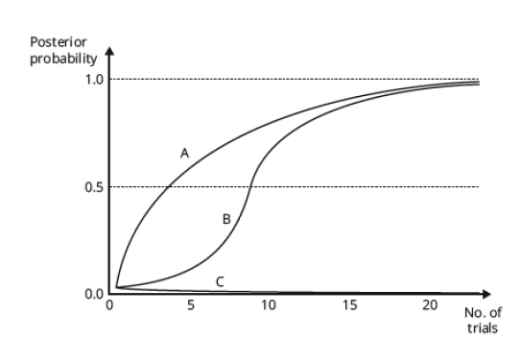
Imagine that John is suffering from confirmation bias. Which of the curves labeled A, B, and C in Figure 5.4 best represents the manner in which his probabilities change over time as the evidence comes in?
Notes:
C

Slide 39
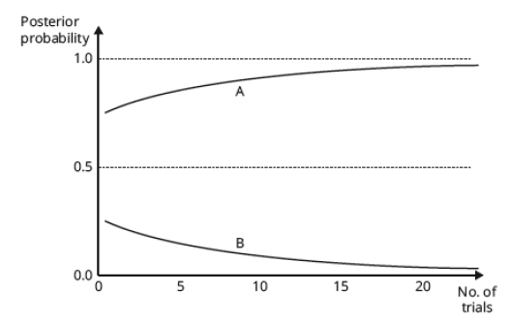

Slide 40
Consequences of Confirmation bias
Racism, sexism and other stereotypes
Gambling
Belief of ability to “beat the market”
Conspiracy theories
Persistence of scientific theories

Slide 41
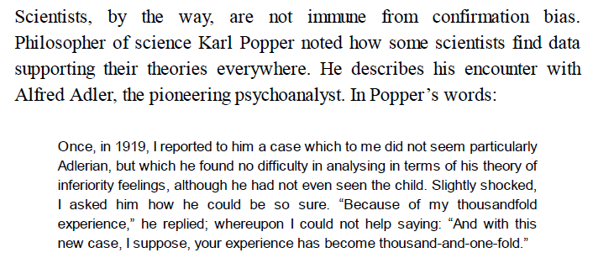
Notes:
Problem of reproducibility

Slide 42
A good question to ask yourself and others is: “What sort of evidence would make you change your mind?” If you cannot think of anything short of divine intervention, you are almost surely suffering confirmation bias.

Slide 44
Example
How would you rank the following animals in terms of deadliness to humans (annual number of human deaths)?
Mosquitos
Snakes
Dogs
Lions
Elephants
Bees
Sharks

Slide 45
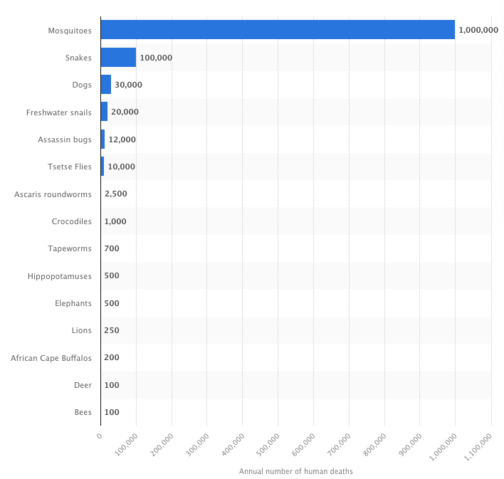
Example

Slide 46
Availability
Availability is the ease with which information can be brought to mind.
The availability heuristic says to assess the probability of an event by reference to its availability.
Like other heuristics, the availability heuristic may be functional but it can also lead us astray.
It can also help explain base-rate neglect. For example in the case of cancer testing: even if you know that there are false-positives, true positives are more likely to come to mind. The availability heuristic will lead to an overestimation of the probability of a true positive.

Slide 47
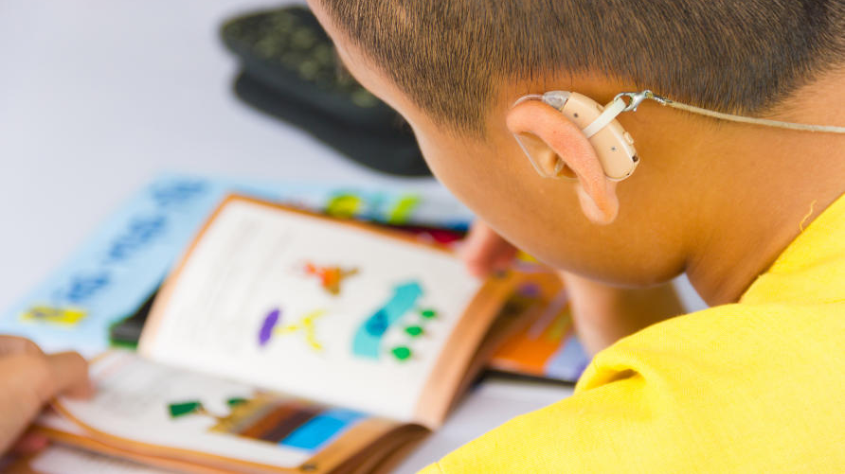
Cytomegalovirus
0.2% - which 20% have hearing loss
Cette photo de Auteur inconnu est fournie sous licence CC BY-ND.

Slide 48
Suppose that you happen to come across an alligator while walking to work. The chances are that images of alligators attacking other animals (including humans) will come to mind more easily than images of alligators acting cute and cuddly.
If so, the availability heuristic tells you to assume the alligator is likely to be dangerous, which is obviously a helpful assumption under the circumstances.
However, the availability heuristic (being a simple rule of thumb) can sometimes lead you astray, as in the case of the children with hearing loss. Thus, like anchoring and adjustment, availability can lead to bias.

Slide 50
Confidence
Weather forecasts usually come with some statement of confidence: e.g. “there is a 80% probability of rain tomorrow”.
Confidence intervals: statements of the type: “There is a 90% probability of the price of a stock being between $125 and $175”
You are calibrated if and only if for all propositions assigned the same probability, the proportion of the propositions that are true equals the probability you assigned.
You can be calibrated even if most of your predictions are wrong: e.g. you only have 33% confidence in your predictions and are correct only 1/3 of the times.

Slide 51
Overconfidence
People (including experts) tend to be overconfident.
Overconfident people express a confidence in their judgements that tends to exceed the frequency with which those are correct.
Typically, overconfidence increases with confidence.

Slide 52
Overconfidence
People (including experts) tend to be overconfident.
Overconfident people express a confidence in their judgements that tends to exceed the frequency with which those are correct.
Typically, overconfidence increases with confidence.

Slide 53
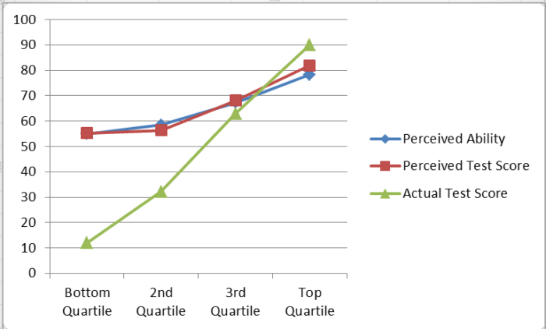
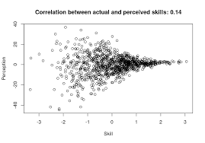
Overconfidence
Typically, overconfidence increases with confidence.
Notes:
People who do not know about stuff don't know how good they are about it.

Slide 54
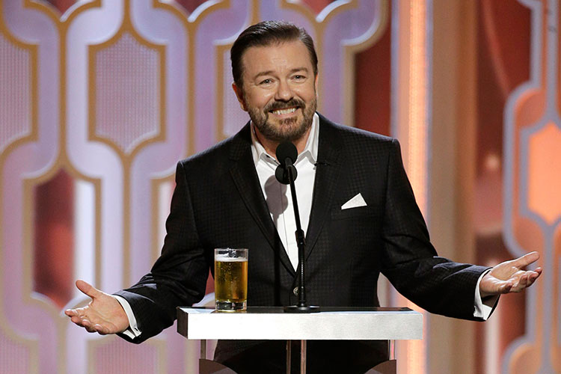
Overconfidence
“When you are dead, you do not know you are dead. It is only painful for others.
The same applies when you are stupid.”
Cette photo de Auteur inconnu est fournie sous licence CC BY-NC.
Notes:
People who do not know about stuff don't know how good they are about it.

Slide 55

Notes:
How many of you have a car ?
How many of you consider yourself a better driver than others ?

Slide 56
Reducing overconfidence
Informing people about the prevalence of overconfidence does not reduce it.
Regular, prompt and unambiguous feedback to highly repetitive judgments helps.

Slide 57
Heuristics used in judgment formation
Anchoring-and-adjustment
Representativeness heuristic
Availability heuristic
Affect heuristic (assign probabilities to consequences, depending on how you feel about the thing they would be consequences of)

